Slide 1
Digital Business and E-Commerce Management
Lesson 10
Setting a Wix Site Part 1

Slide 2
Setting a Wix Site
At the end of this lesson, you will be able to
Set-up an account in Wix
Build a new Site and select a new template
Customize the contents of the template selected
Manage products

Slide 3
Activity 10.1
Refer to your book for Activity 10.1

Slide 4
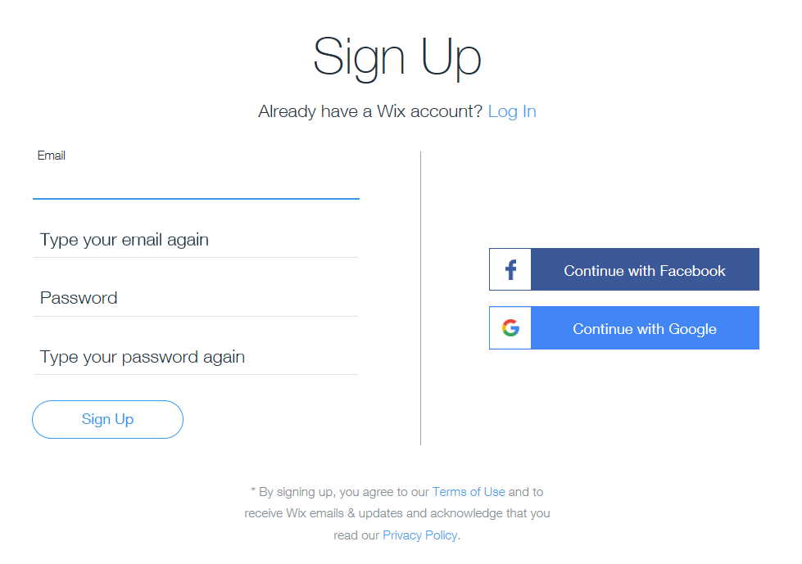
Sign-up for a Wix Account
Set-up an account in Wix. You can use either your Facebook account or Gmail account to Sign-up

Slide 5
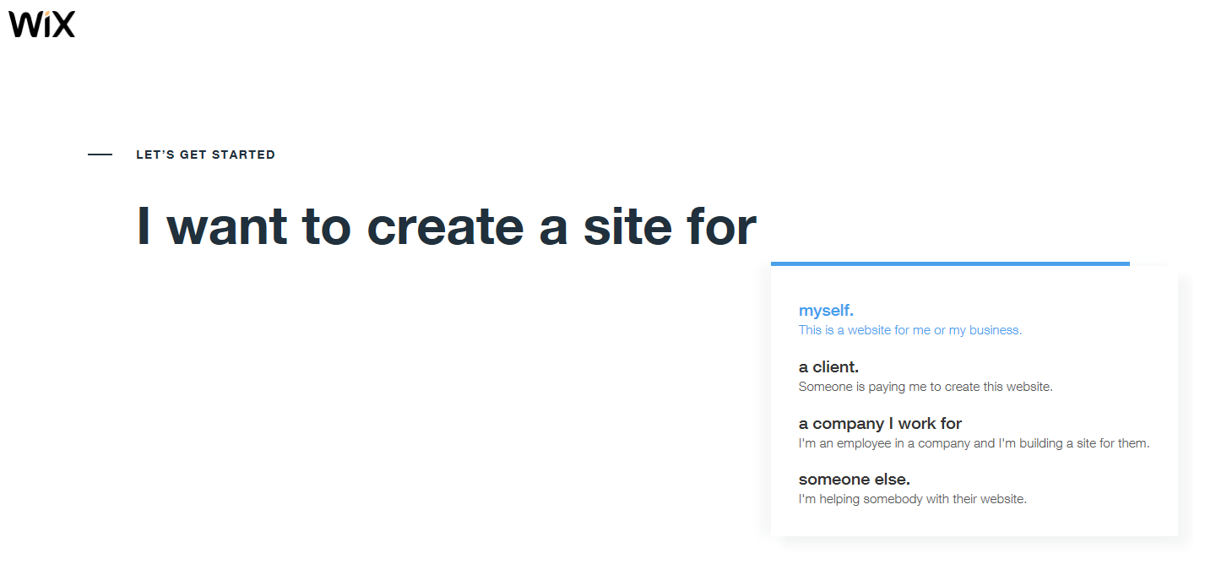
Sign-up for a Wix Account
After you sign-up using your FB or Gmail account. Select one of the choices that will describe your goal of setting the Wix site.

Slide 6
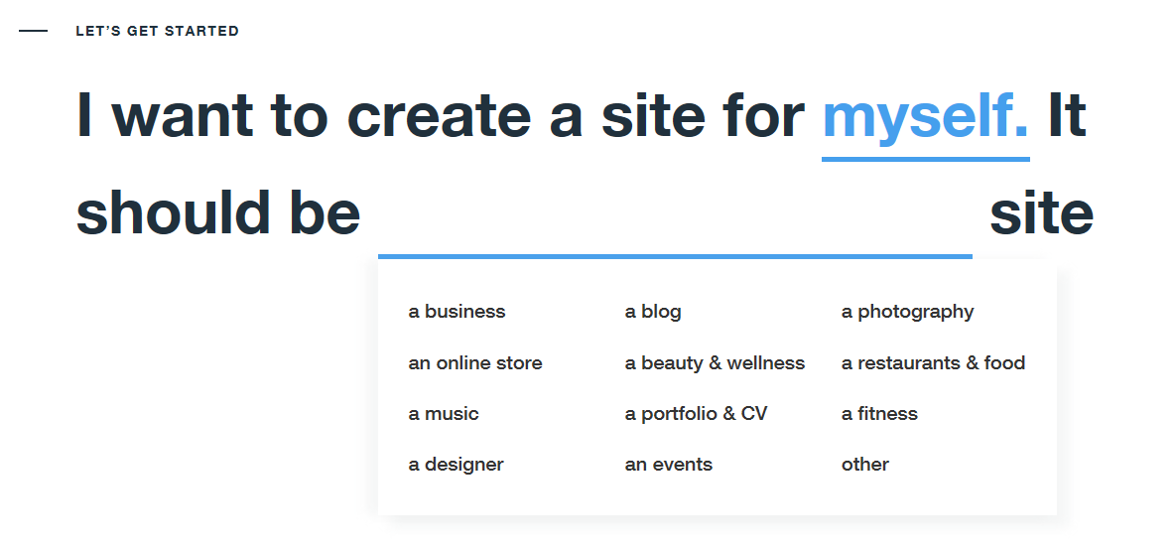
Sign-up for a Wix Account
This section allows you to select the basic idea of what your site is all about

Slide 7
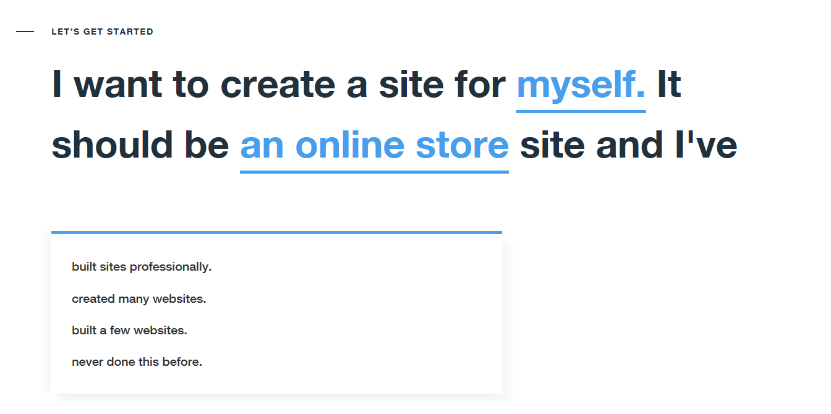
Sign-up for a Wix Account

Slide 8
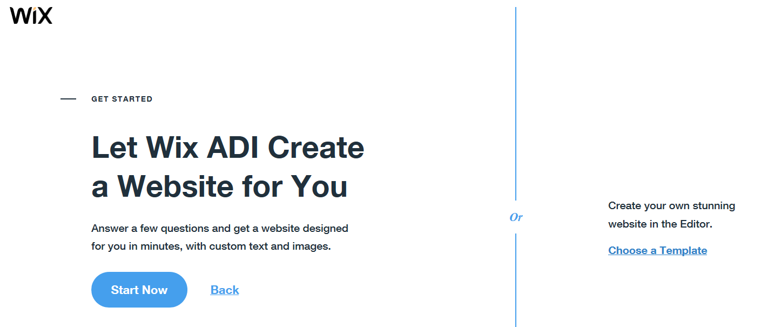
Sign-up for a Wix Account
You can use select your own Template or use a Wix ADI (Artificial Design Intelligence).

Slide 9
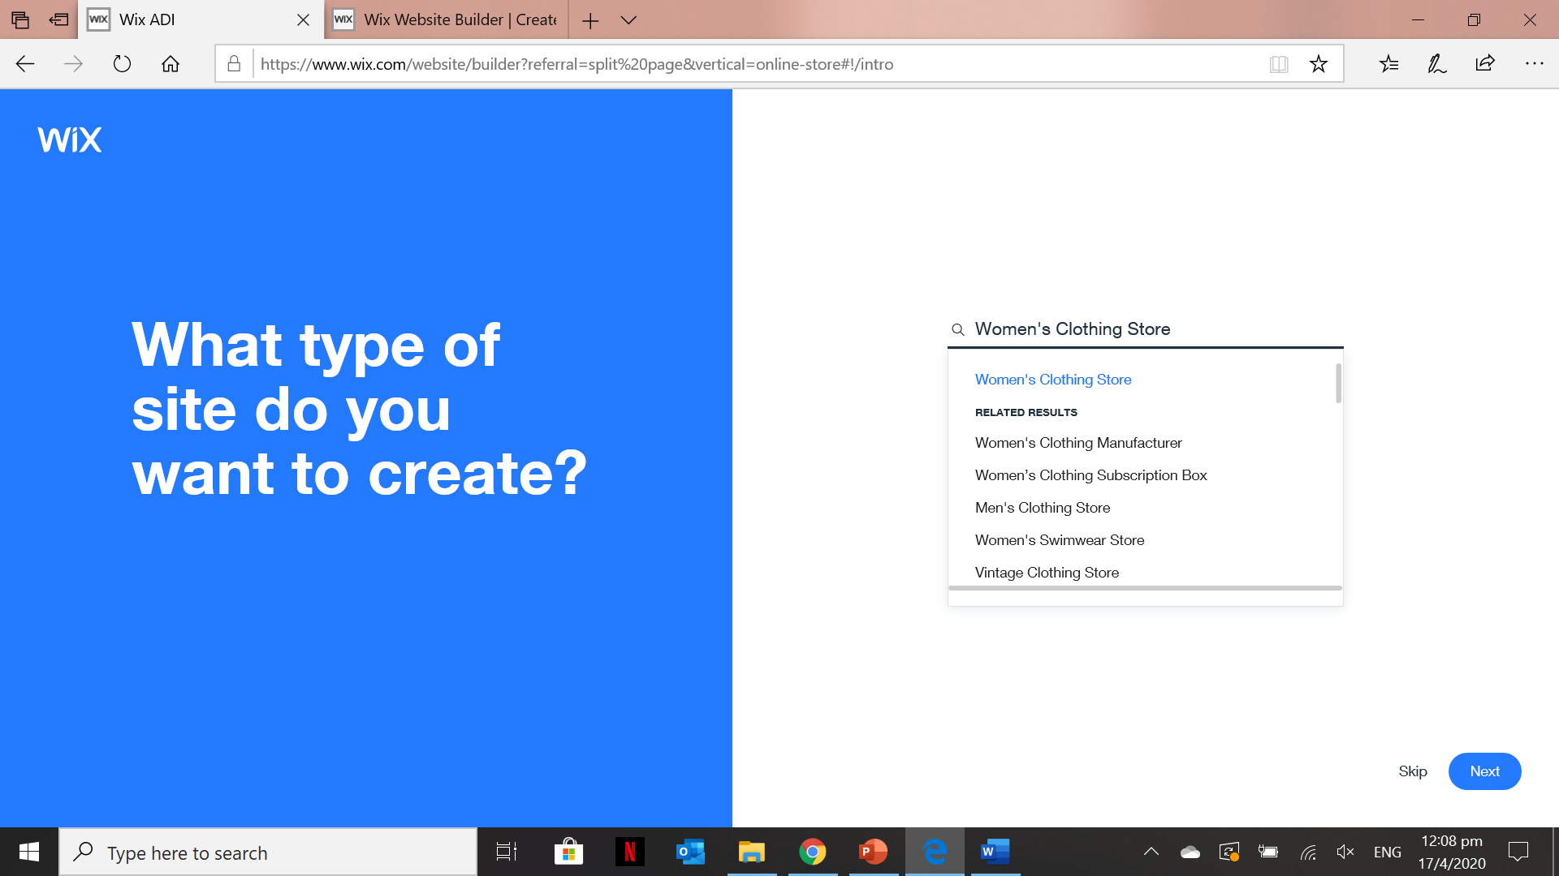
Sign-up for a Wix Account (Using Wix ADI)
To start using the Wix ADI, you just need to answer a few questions associated with the E-commerce site you want to create

Slide 10
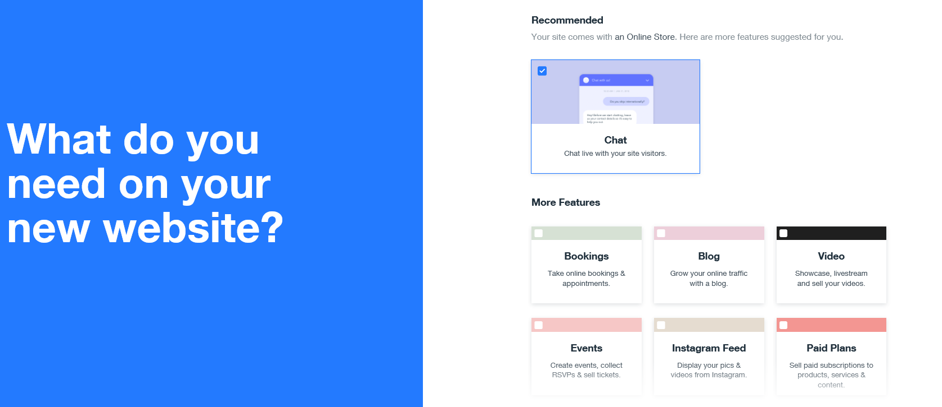
Sign-up for a Wix Account (Using Wix ADI)
You can select some of the features you want to add in your site

Slide 11

Sign-up for a Wix Account (Using Wix ADI)
You can set the name of your online store or your business at this stage of Wix ADI.

Slide 12
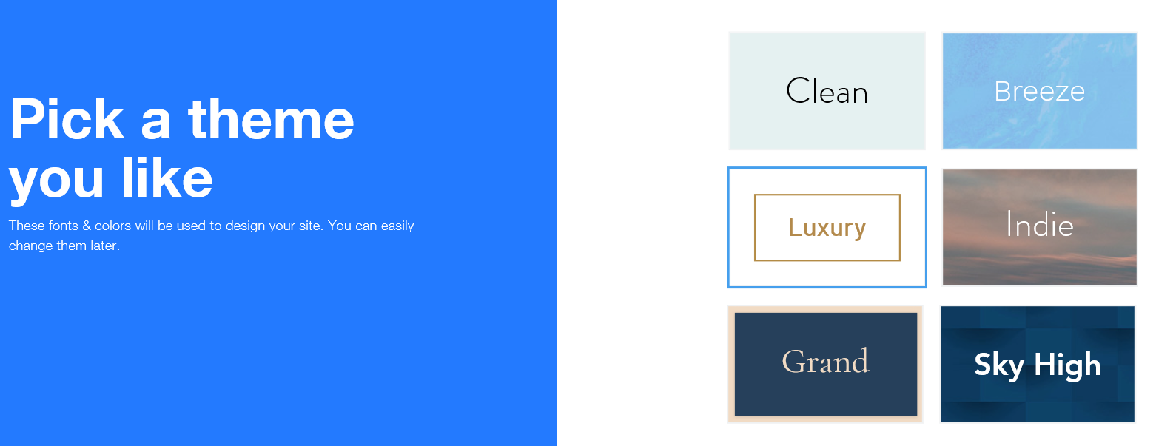
Sign-up for a Wix Account (Using Wix ADI)
In this stage, you need to select theme that you will apply to your site.

Slide 13
Sign-up for a Wix Account (Using Wix ADI)
In this stage, you need to select theme that you will apply to your site.

Slide 14
Activity 10.2
Refer to your book for Activity 10.2

Slide 15
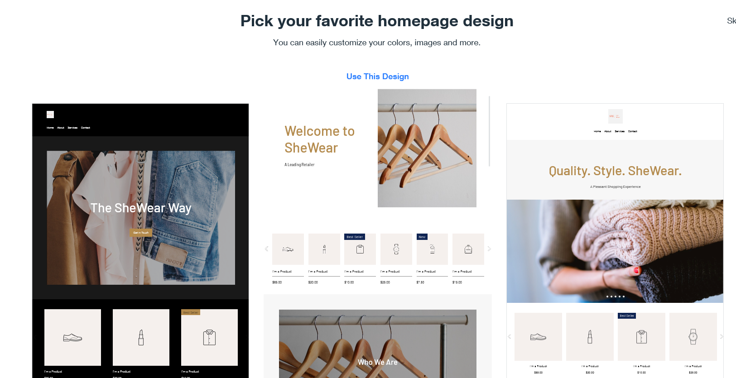
Sign-up for a Wix Account (Using Wix ADI)

Slide 16
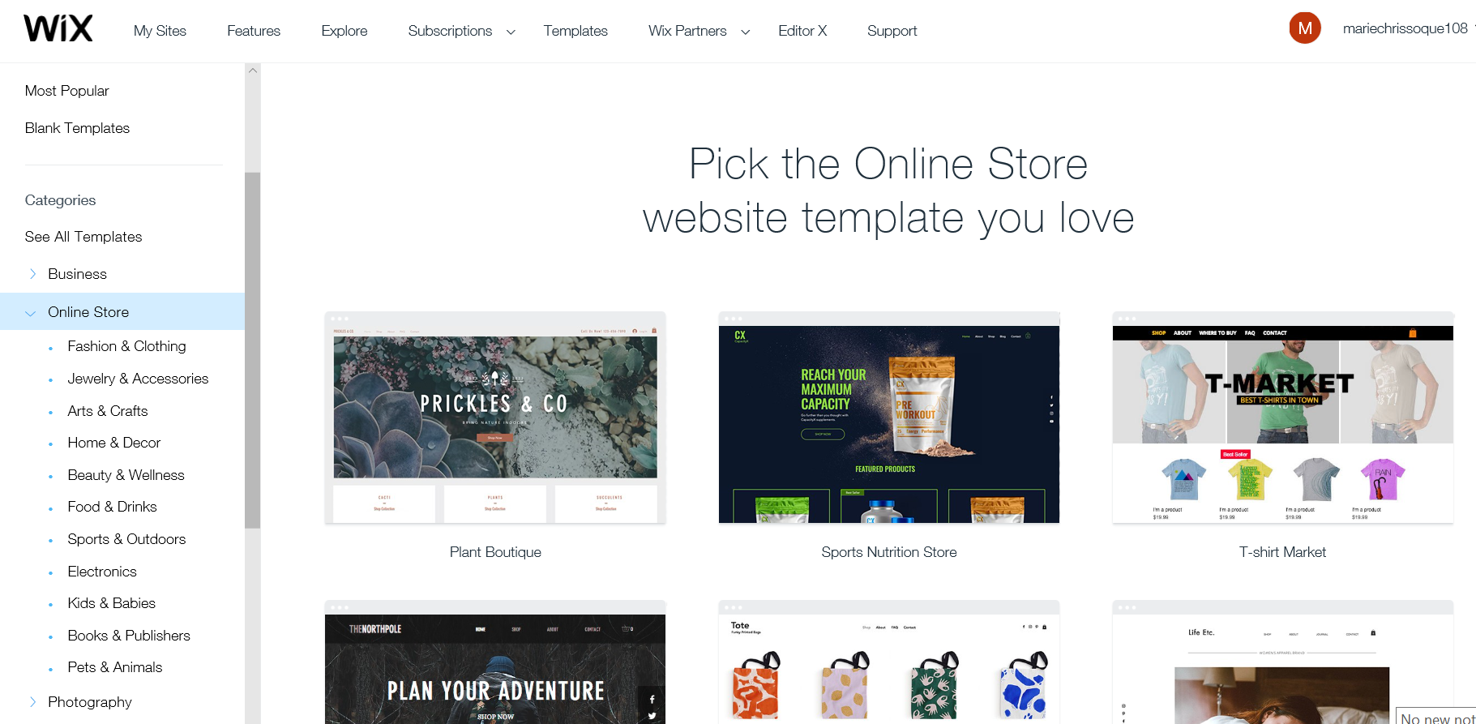
Sign-up for a Wix Account (Using a Template)
You can select online store website template which is appropriate to the products & services you are selling.

Slide 17
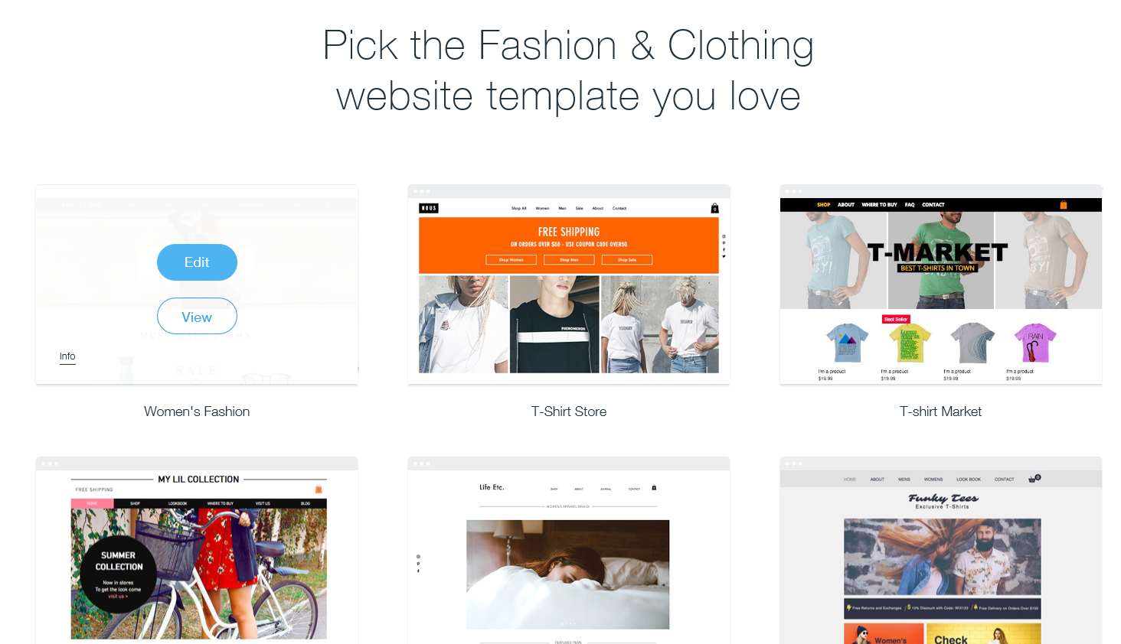
Sign-up for a Wix Account (Using a Template)
Once you selected a template. You can View it to see the template’s preview or straight away click Edit to customize it.

Slide 18
Activity 10.3
Refer to your book for Activity 10.3

Slide 19
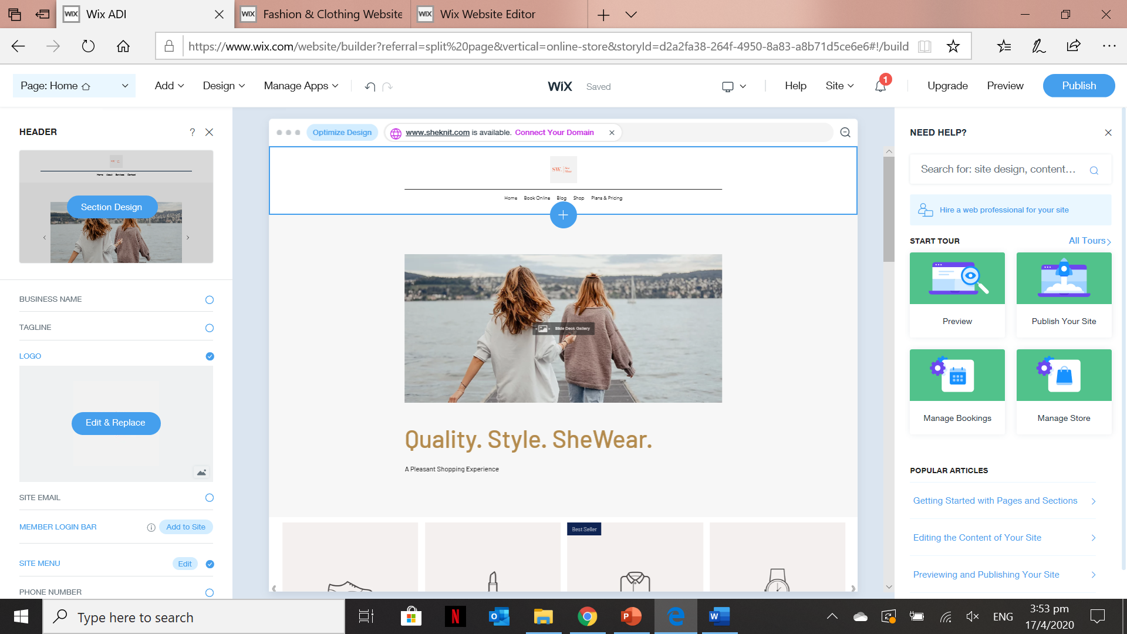
Customizing and Editing the contents of Wix ADI template-Site Header Section
Select the Header section of the Home Page and go to the Side to customize and edit the elements like business name, logo, tagline, site menu and etc.
Sections to customize and edit the each of the elements of the Header

Slide 20
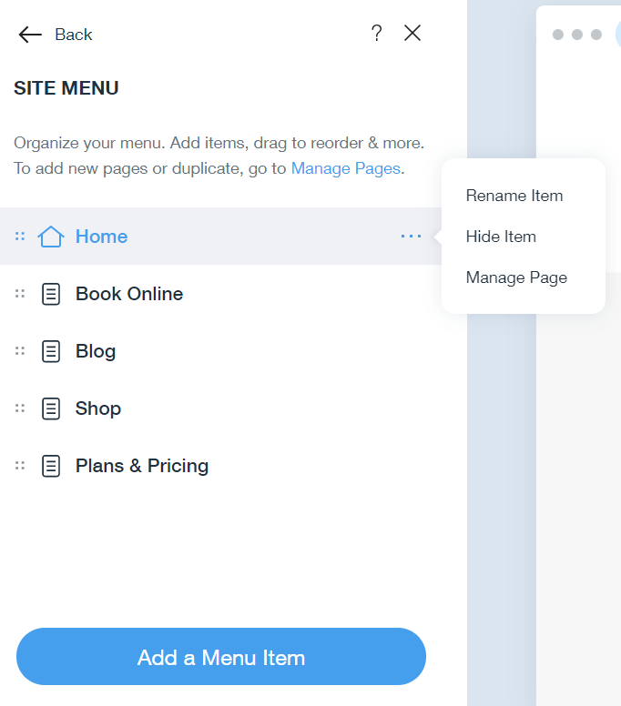
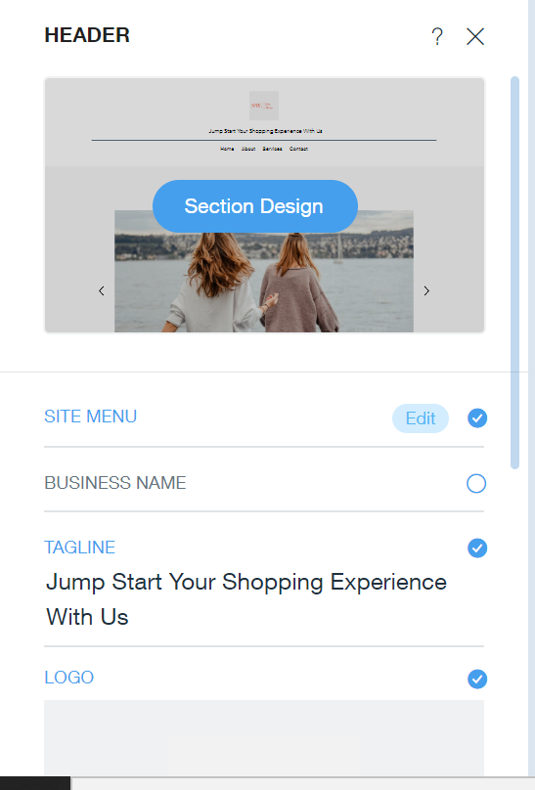
Customizing and Editing the contents of Wix ADI template-Site Header Section
Edit and Customize the Menu items
Add new menu items

Slide 21
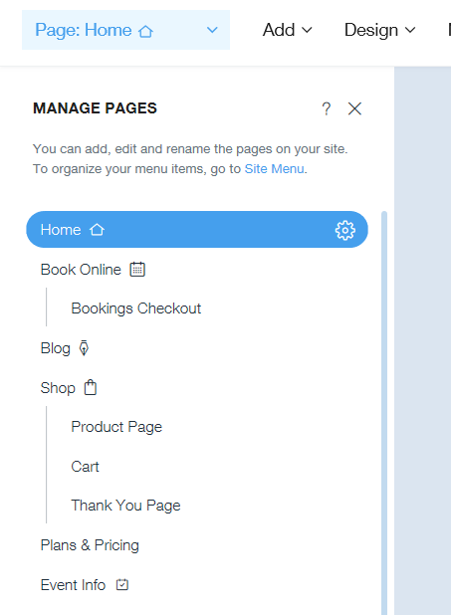
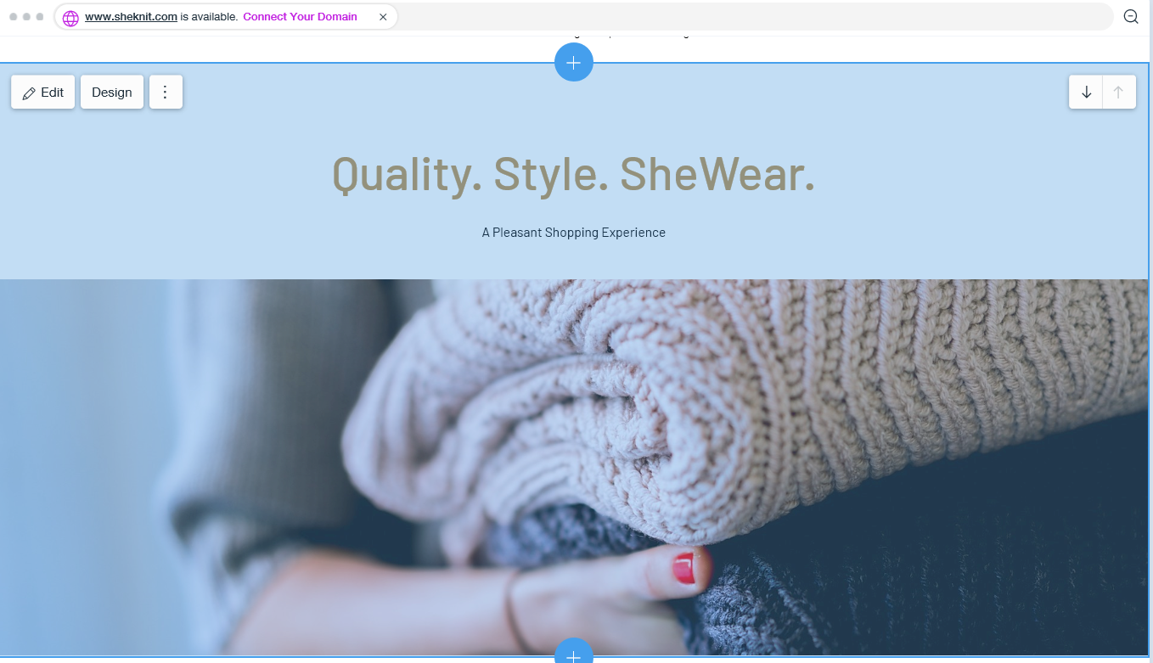
Customizing and Editing the contents of Wix ADI template- Welcome Section
Click Edit and customize the necessary elements

Slide 22
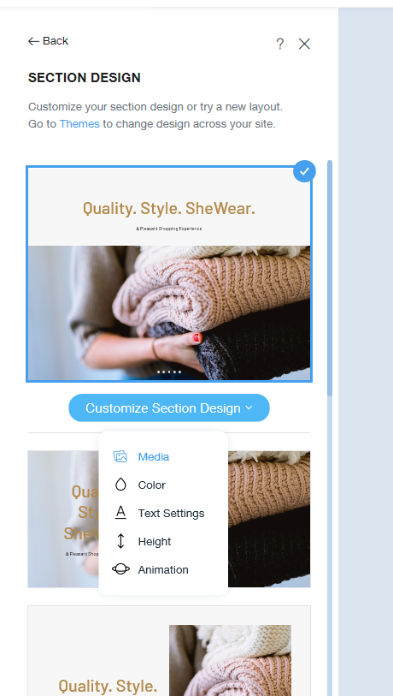
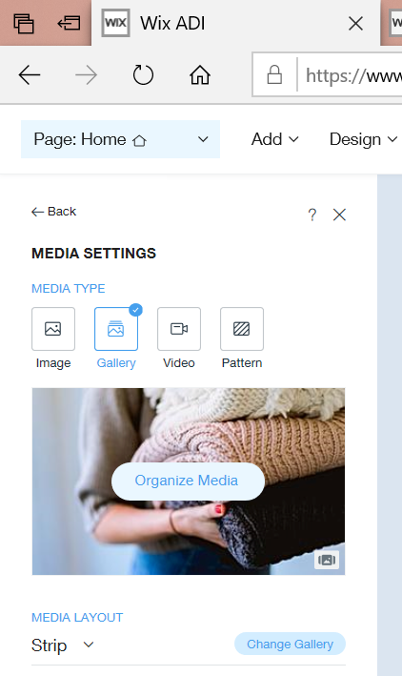
Customizing and Editing the contents of Wix ADI template – Welcome Section
Customized the media according to how you want this section to look like.

Slide 23
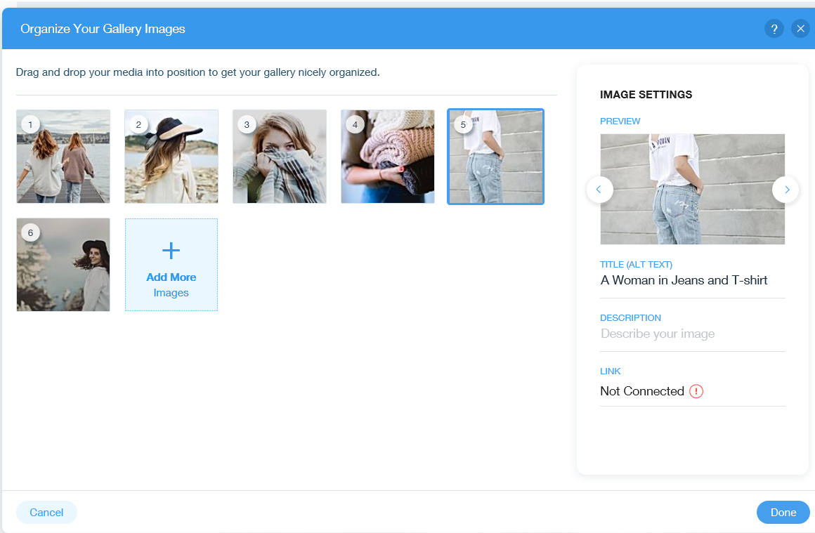
Customizing and Editing the contents of Wix ADI template- Welcome Section
Settings to change the Image title, description and link.
You can rearrange the default images by dragging it to your desired order

Slide 24
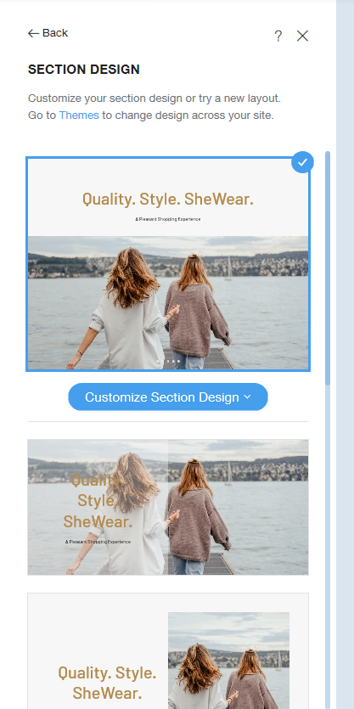
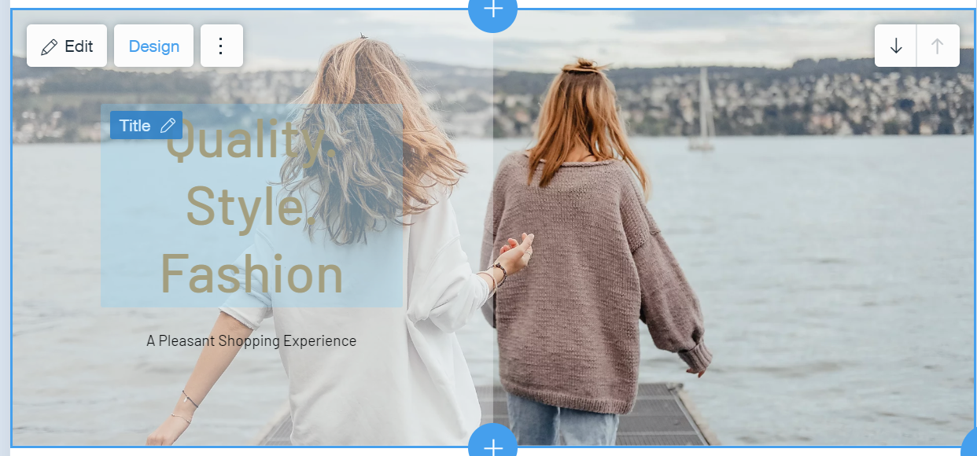
Customizing and Editing the contents of Wix ADI template- Welcome Section
This section allows you to customize the Welcome Layout Design, the Media type settings and etc. There are other settings that you can customize E.g. Colours, Fonts, Animation

Slide 25
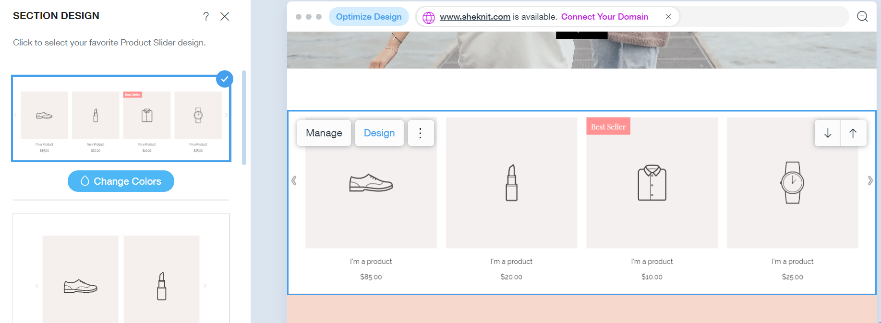
Customizing and Editing the contents of Wix ADI template- Product Feature Section
To change the layout design of the product section feature. There are several available layouts that you can choose from.

Slide 26
Customizing and Editing the contents of Wix ADI template- Manage Product
Allows you to manage the products in your site. Once clicked it redirects to the Wix Dashboard which enable you to “Add the Product”

Slide 27
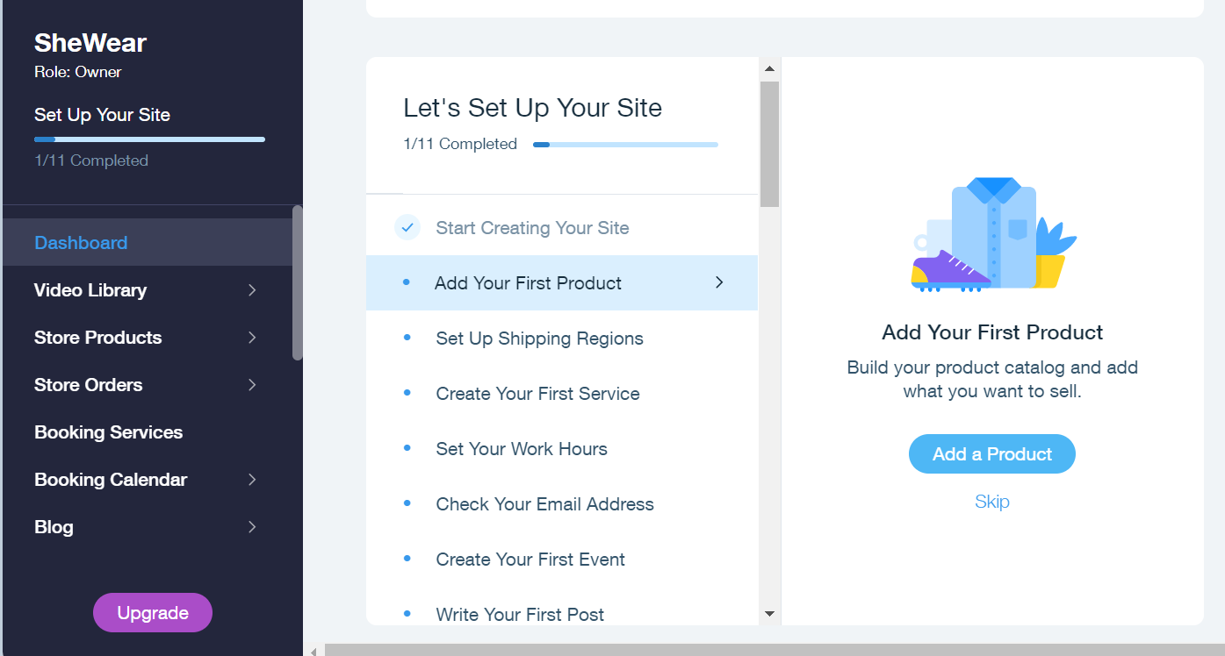
Customizing and Editing the contents of Wix ADI template- Manage Product
Add a new product by clicking this button.

Slide 28
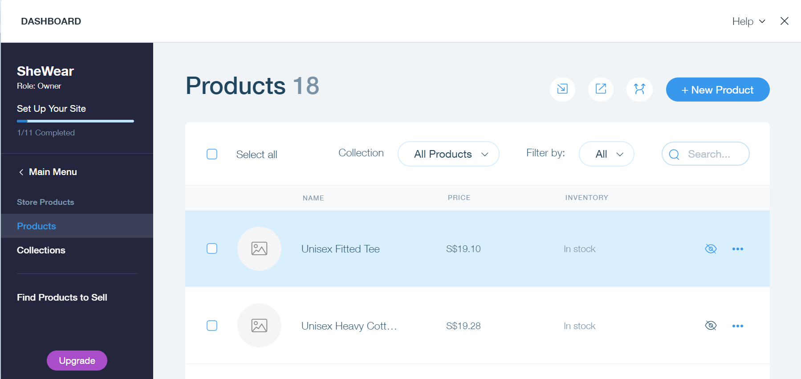
Customizing and Editing the contents of Wix ADI template- Manage Product
Click the button to add a new product in your website.

Slide 29
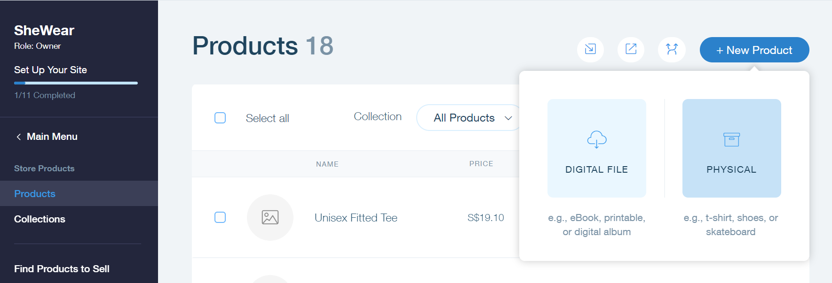
Customizing and Editing the contents of Wix ADI template- Manage Product
When you add a new product you can select whether it is a physical product or a digital file

Slide 30
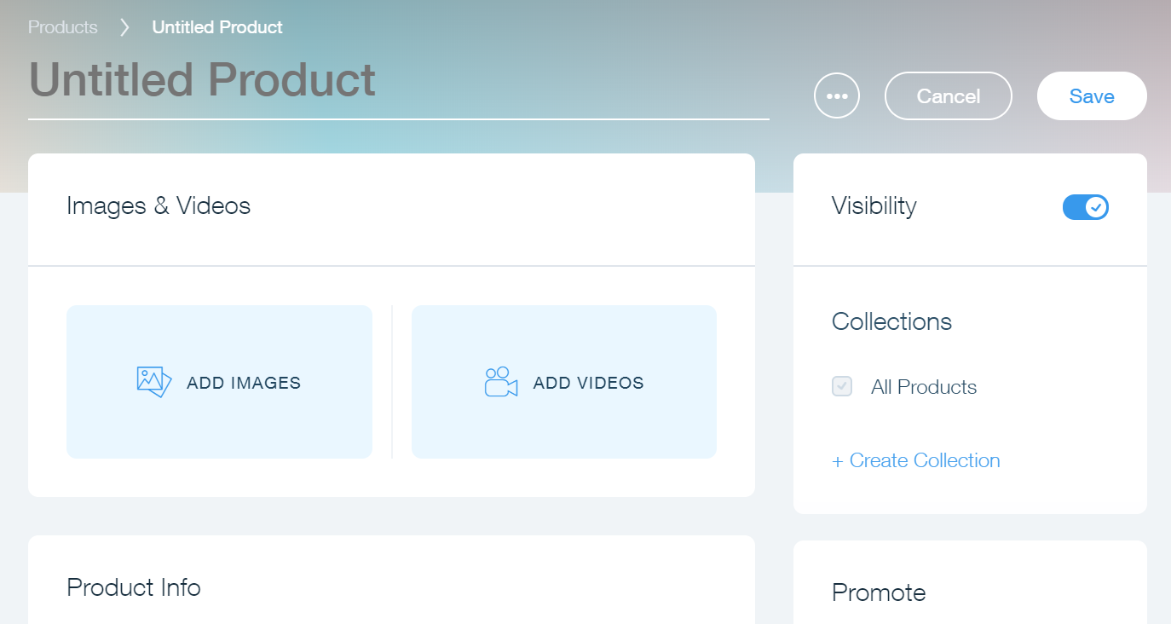
Customizing and Editing the contents of Wix ADI template- Manage Product
This page allows you to provide the information of the product in your site.

Slide 31
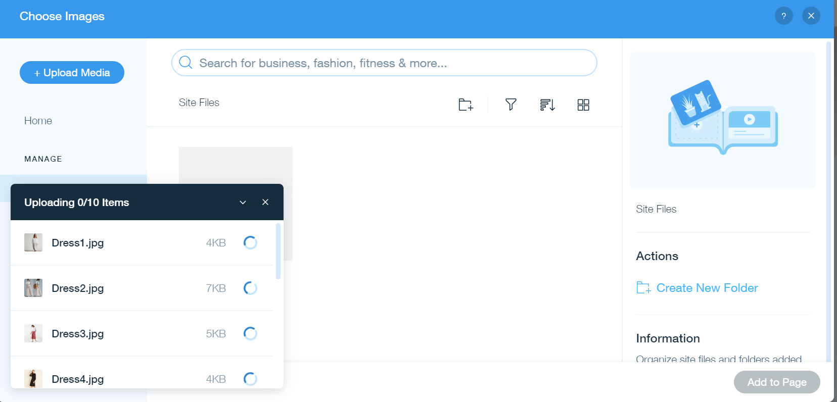
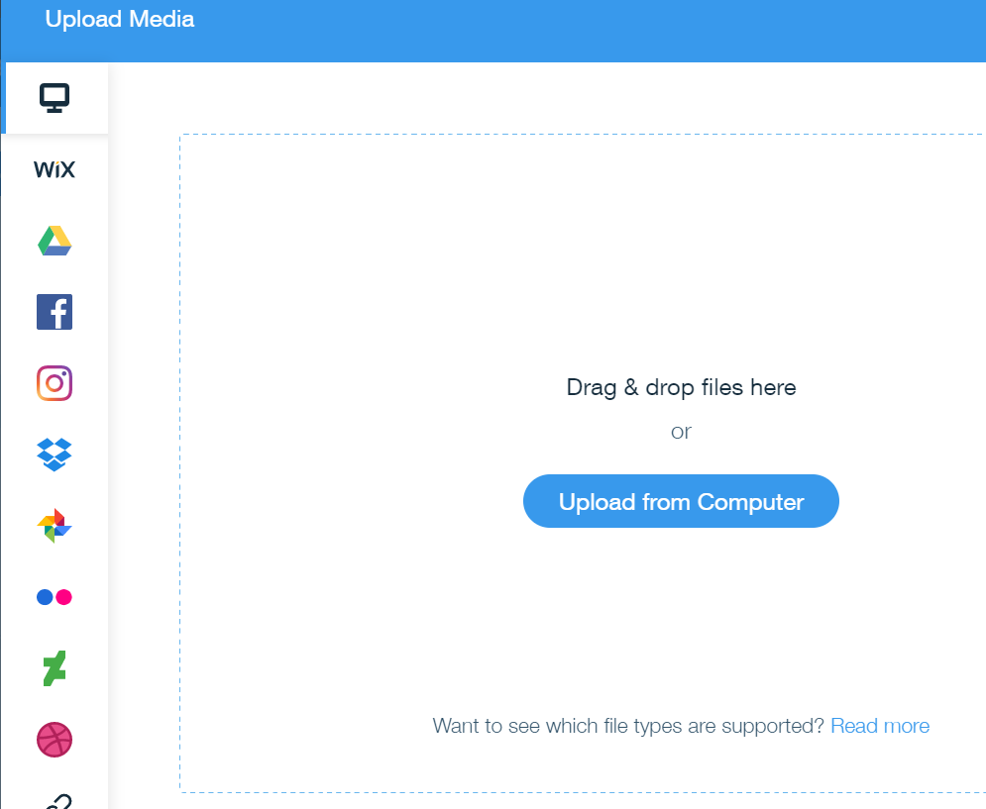
Customizing and Editing the contents of Wix ADI template- Manage Product
You can get the images from social Media, the cloud drives and from your local device.

Slide 32
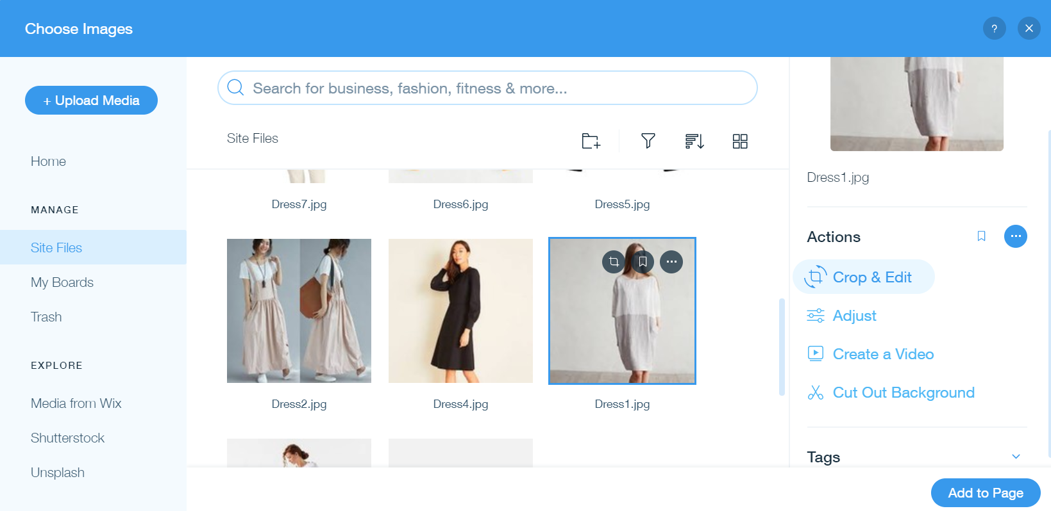
Customizing and Editing the contents of Wix ADI template- Manage Product
You can perform several actions on the image of your product E.g. Editing, Adjusting and/or creating a video.
Once every properties of the product image is customized and set. You can click this button to add in the page.

Slide 33
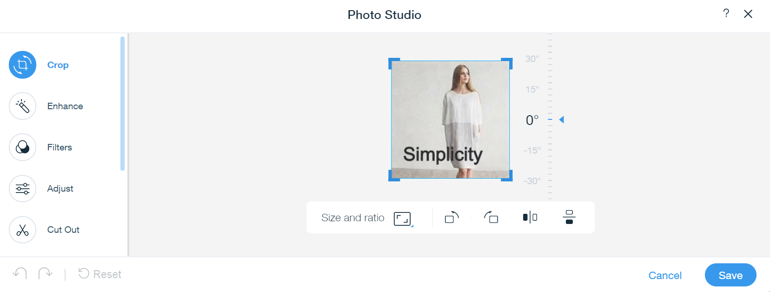
Customizing and Editing the contents of Wix ADI template- Manage Product
The “Crop” and “Adjust” Actions that you can perform with image. Once edited don’t forget to save. A new file will be created and saved in the site file.C

Slide 34
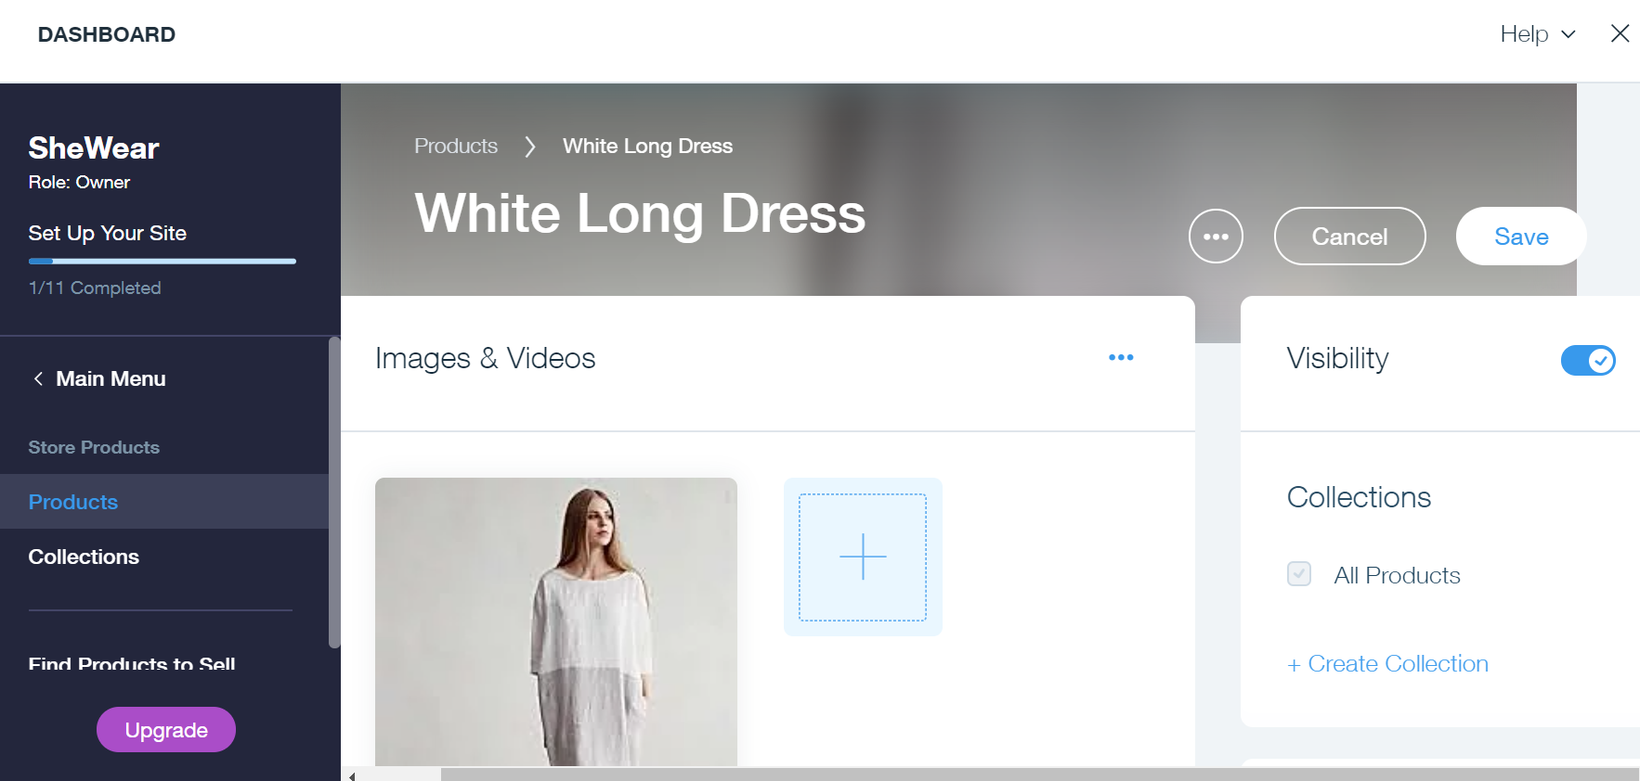
Customizing and Editing the contents of Wix ADI template- Manage Product
In this section, you can change the product information. E.g. Product Name, Description, Price, Images, In Stock information, Delivery Information, and etc.

Slide 35
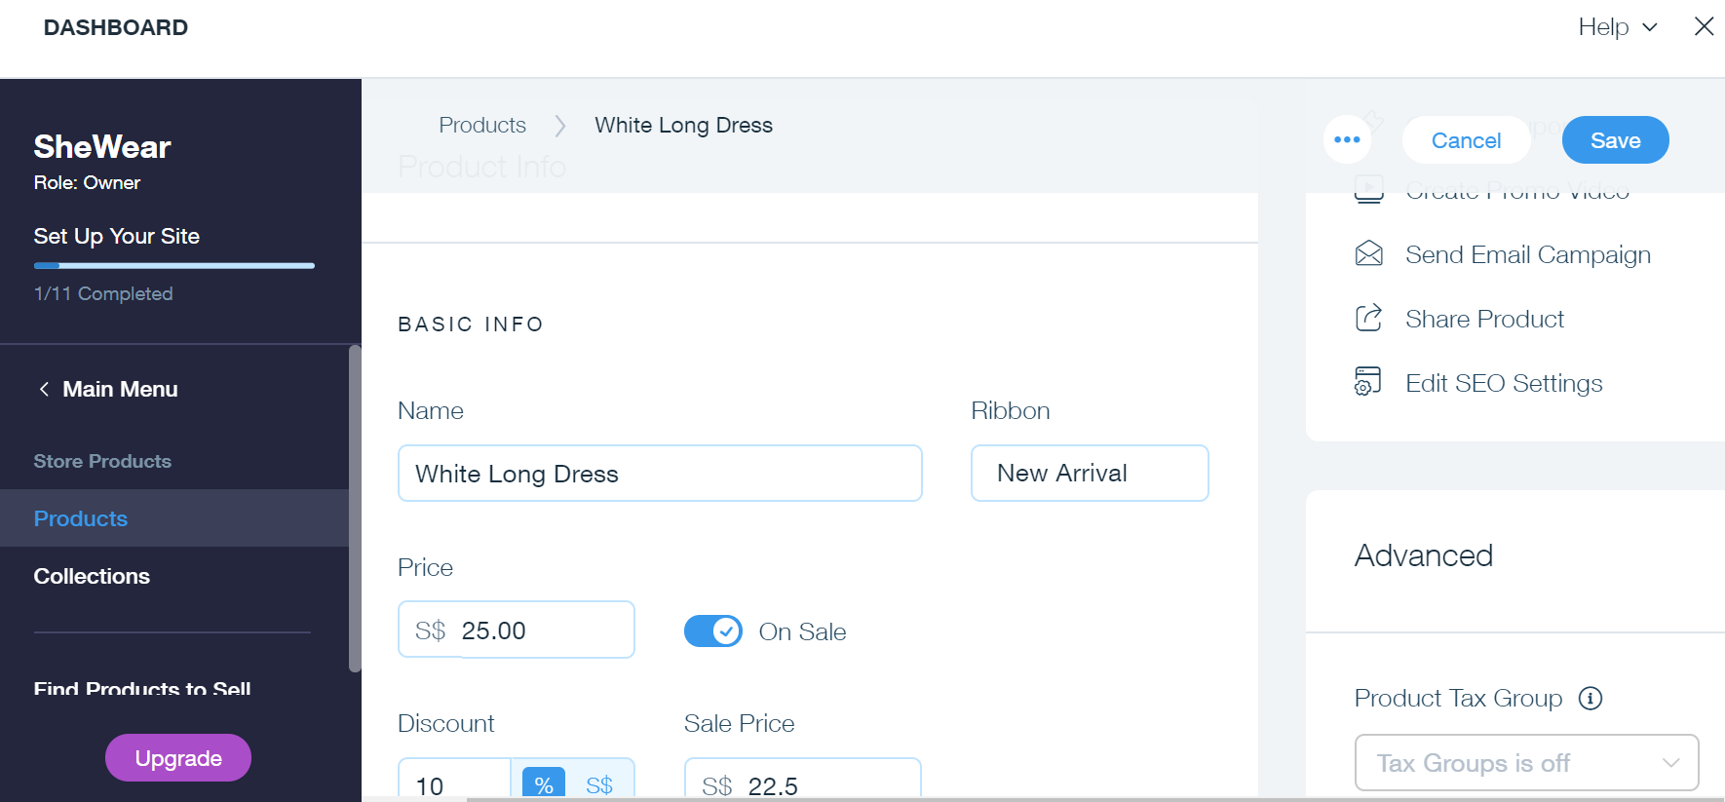
Customizing and Editing the contents of Wix ADI template- Manage Product
In this section, you can change the product information. E.g. Product Name, Description, Price, Images, In Stock information, Delivery Information, and etc.

Slide 36
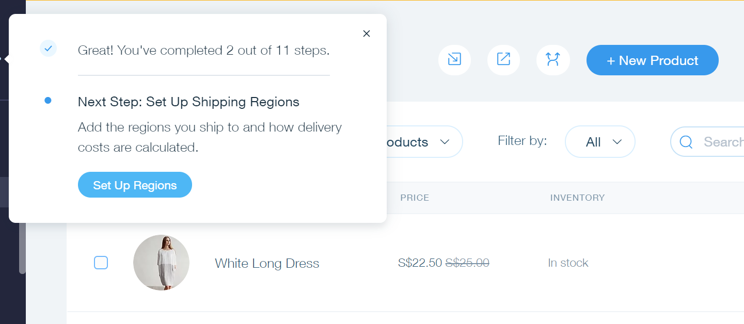
Customizing and Editing the contents of Wix ADI template- Manage Product
In the Manage Product Page, you can also customize the Shipping Information. E.g. Shipping region and/or Shipping rate

Slide 37
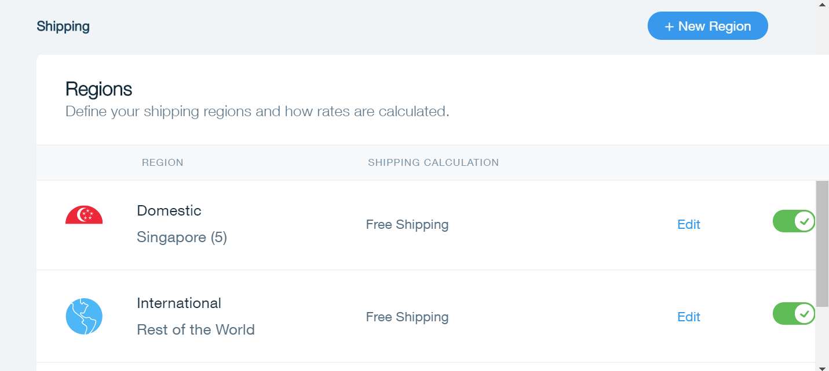
Customizing and Editing the contents of Wix ADI template- Manage Product
In this section, you can edit the domestic or rest of the world

Slide 38
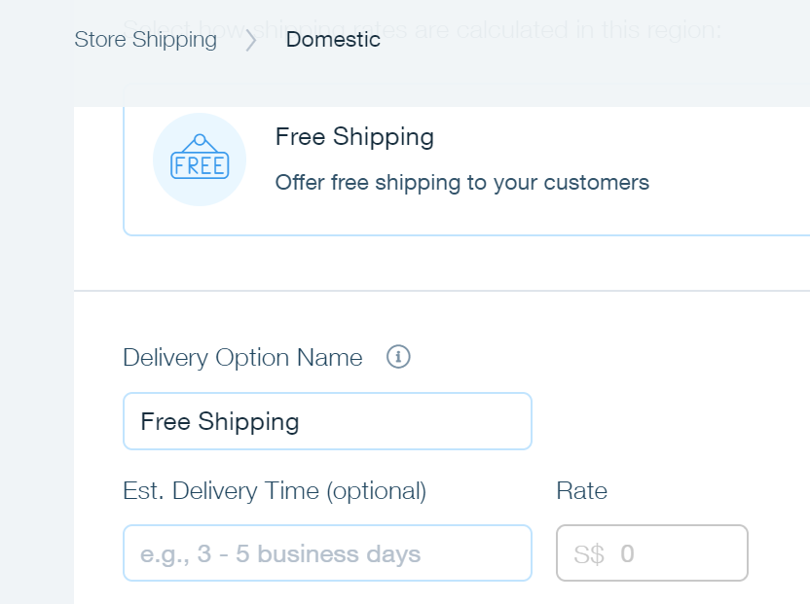
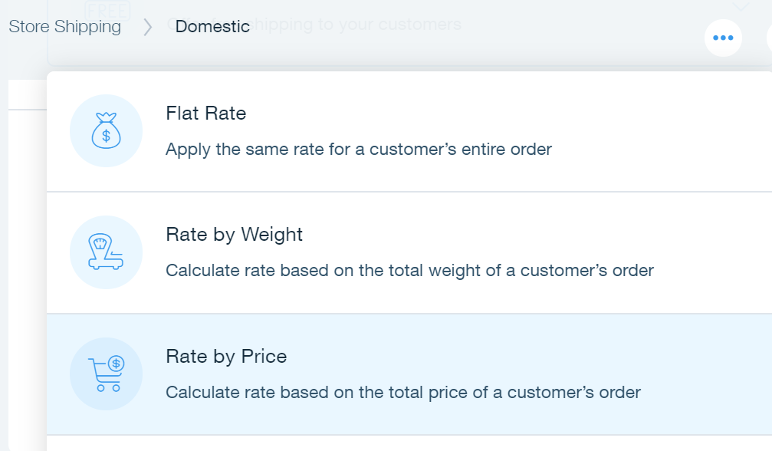

Customizing and Editing the contents of Wix ADI template- Manage Product
In this section, you can customize the delivery option, delivery time and the price range

Slide 39
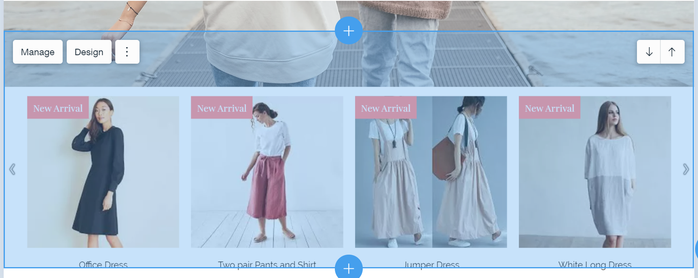
Customizing and Editing the contents of Wix ADI template- Manage Product
Once done of adding products, it will be displayed in the home page of your site.

Slide 40
Activity 10.4
Refer to your book for Activity 10.4

Slide 41
Portfolio – Setting Wix Account, Customizing Template and Adding Products
The contents of your portfolio for this lesson are the following:
Set-up a Wix Account
The selected Wix ADI template applied in the site
Customization of the Home Page
Added ten (10) product information in the Wix site

